Slide 1


COVID-19 Presentation
March 5th, 2020

Slide 2
Agenda
Welcome and Introductions
Overview of COVID-19 and NCCC Response
  What, Where, Who about COVID-19
  North Country CC Response
  SUNY Response
Preventative Measures
  Personal
  Community
Resources

Slide 3
COVID-19 aka Novel Coronavirus
What it is?
  https://www.hopkinsmedicine.org/coronavirus/
  Symptoms include cough, fever and difficulty breathing
How is it spread?
  Human-to-human
  Airborne (coughs, sneezes)
  Possibly from contaminated surfaces
Where is it?

Slide 4
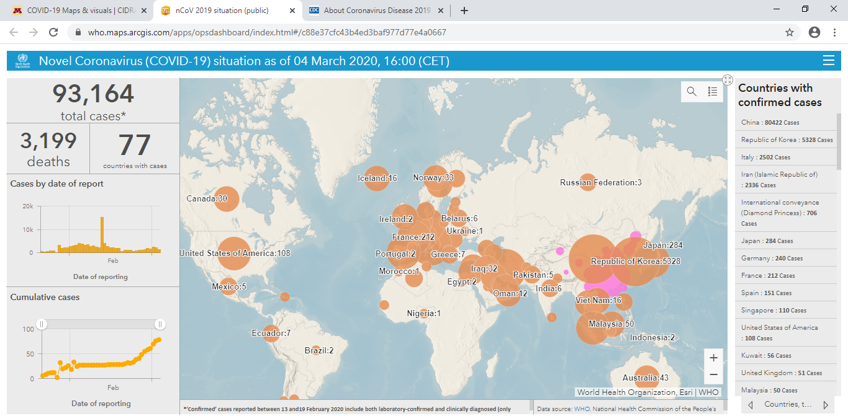

Slide 5
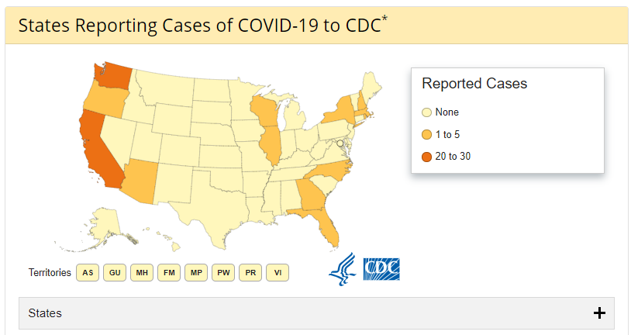
As of March 4th, 2020. Source: https://www.cdc.gov/coronavirus/2019-ncov/cases-in-us.html

Slide 6
NCCC Response
Convened COVID-19 Task Force charged with formulating College’s response
  Includes faculty, staff, administration and Association
Working and communicating with the College community
Directing cleaning staff to disinfect desks, keyboards
Communicating and collaborating with regional health care partners
Adirondack Health Infection Specialist invited to speak to students
Working with SUNY
Presentations such as this

Slide 7
SUNY Steps
Partnering with Department of Health and other state departments in formulating plan and response
Daily convenings and communiques with campuses
Concluding study-abroad programs in highly impacted countries
Recommending hold on international travel

Slide 8
Personal Protective Measures
Recommended:
Personal space/social distancing/6 feet
Protective coughing and sneezing www.cdc.gov/healthywater/hygiene/etiquette/coughing_sneezing.html
Avoid touching your face
Proper hand-washing https://youtu.be/3PmVJQUCm4E
Practicing good hygiene (personal and rooms)
If you develop symptoms or have been in close contact with a person with COVID-19, then quarantine yourself and call your health care professional

Slide 9
Personal Protective Measures
Not Recommended:
Wearing protective masks (unless you are sick) or are in a workplace where it is suggested
Not following the prior guidelines

Slide 10
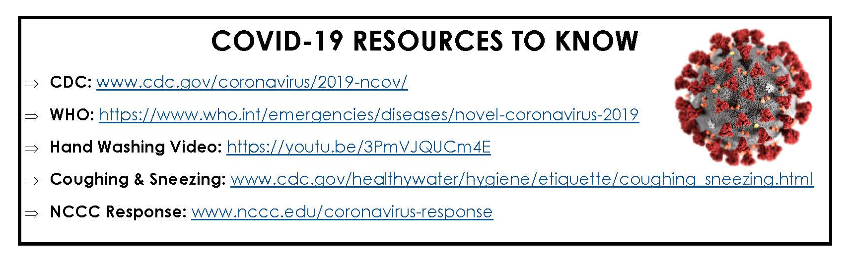
Resources

Slide 11
Short-term Steps
If you feeling some combination of fever, cough and difficulty breathing,
    seek out medical assistance (start with phone call),
    self-quarantine
    notify the College of your status
Engage in preventative practices (handwashing, coughing, distancing)
Spring Break: if traveling outside of the area for Spring Break, we will be asking you to self-report your travels so we can limit the campus exposure to COVID-19

